Slide 1


Qingdao Puye Steel Co., Ltd.
青岛浦冶钢铁有限公司

Slide 2
lntroduction

Slide 3
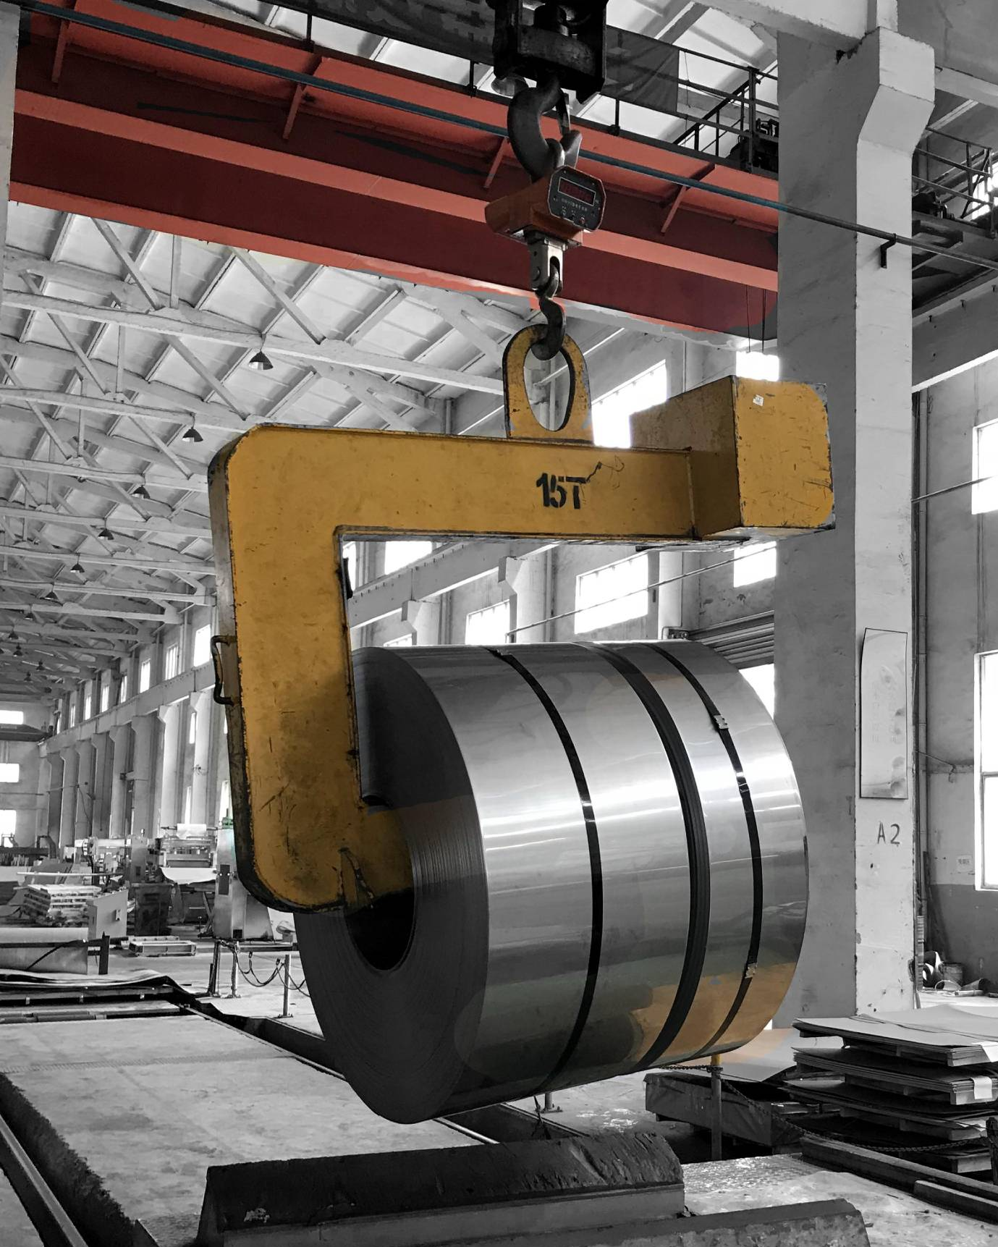
Company
Introduction
Qingdao Puye Steel Co., Ltd is a large-scale carbon steel, stainless steel, galvanized steel, and aluminum trading enterprise, integrating the production, wholesale, storage, and distribution of stainless steel/carbon steel/galvanized steel/aluminum coils, sheets, strips, pipes, etc. Qingdao Puye Steel is located in Shandong Province, one of the country's steel trading centers. Our factory covers an area of 60,000 square meters. At present, we have five finishing rolling production lines and two hot rolling production lines.

Slide 4
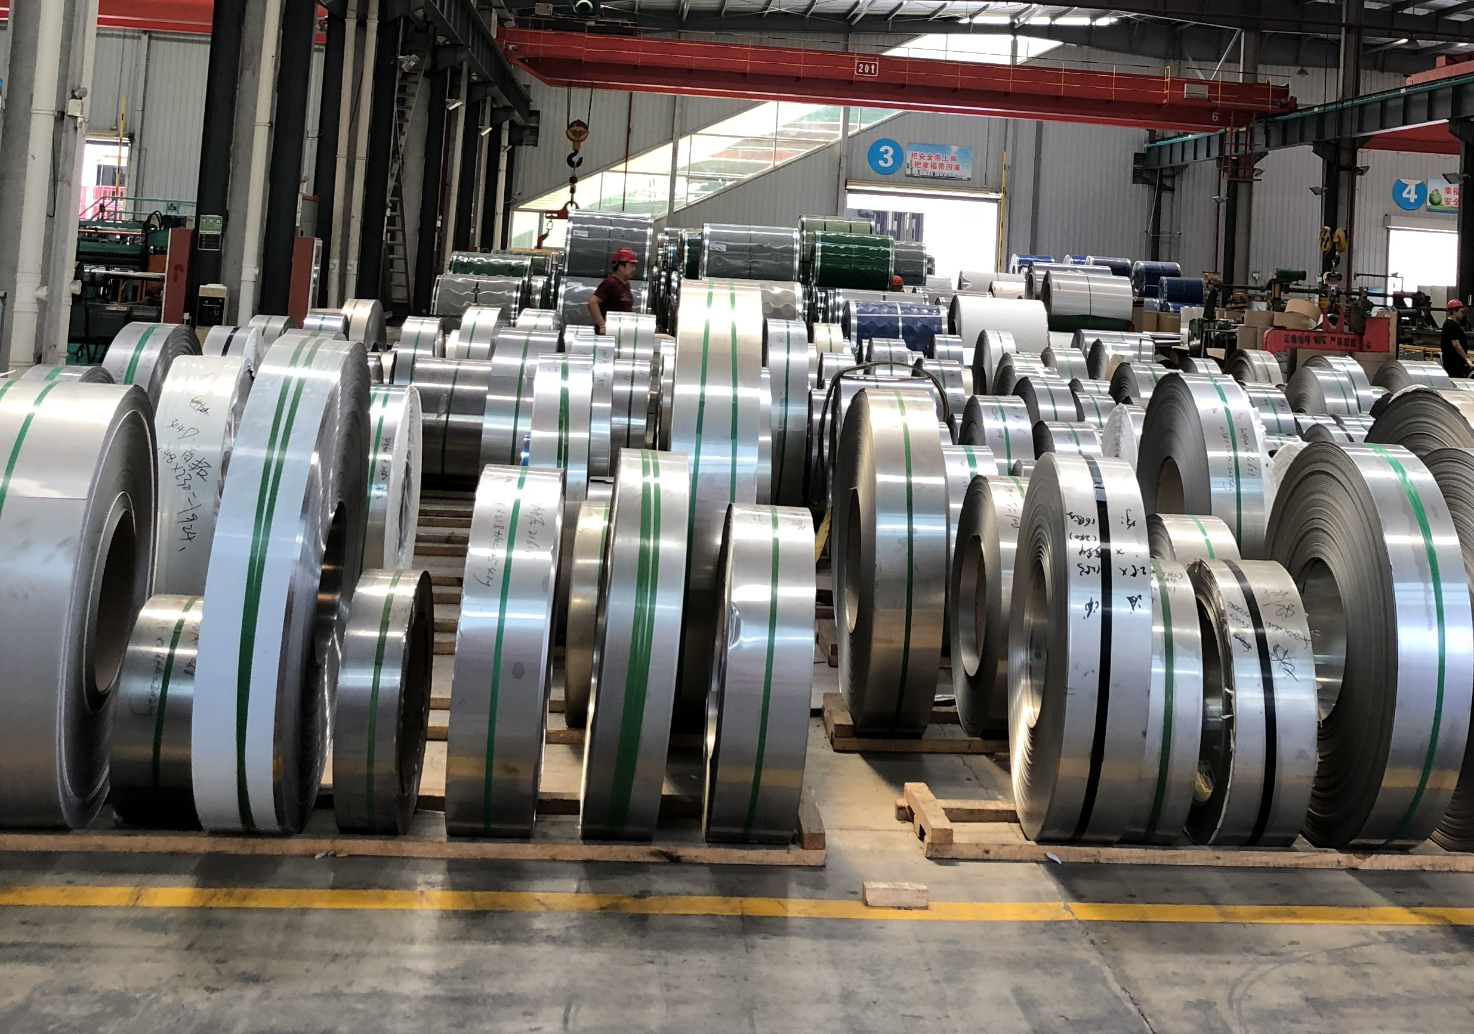
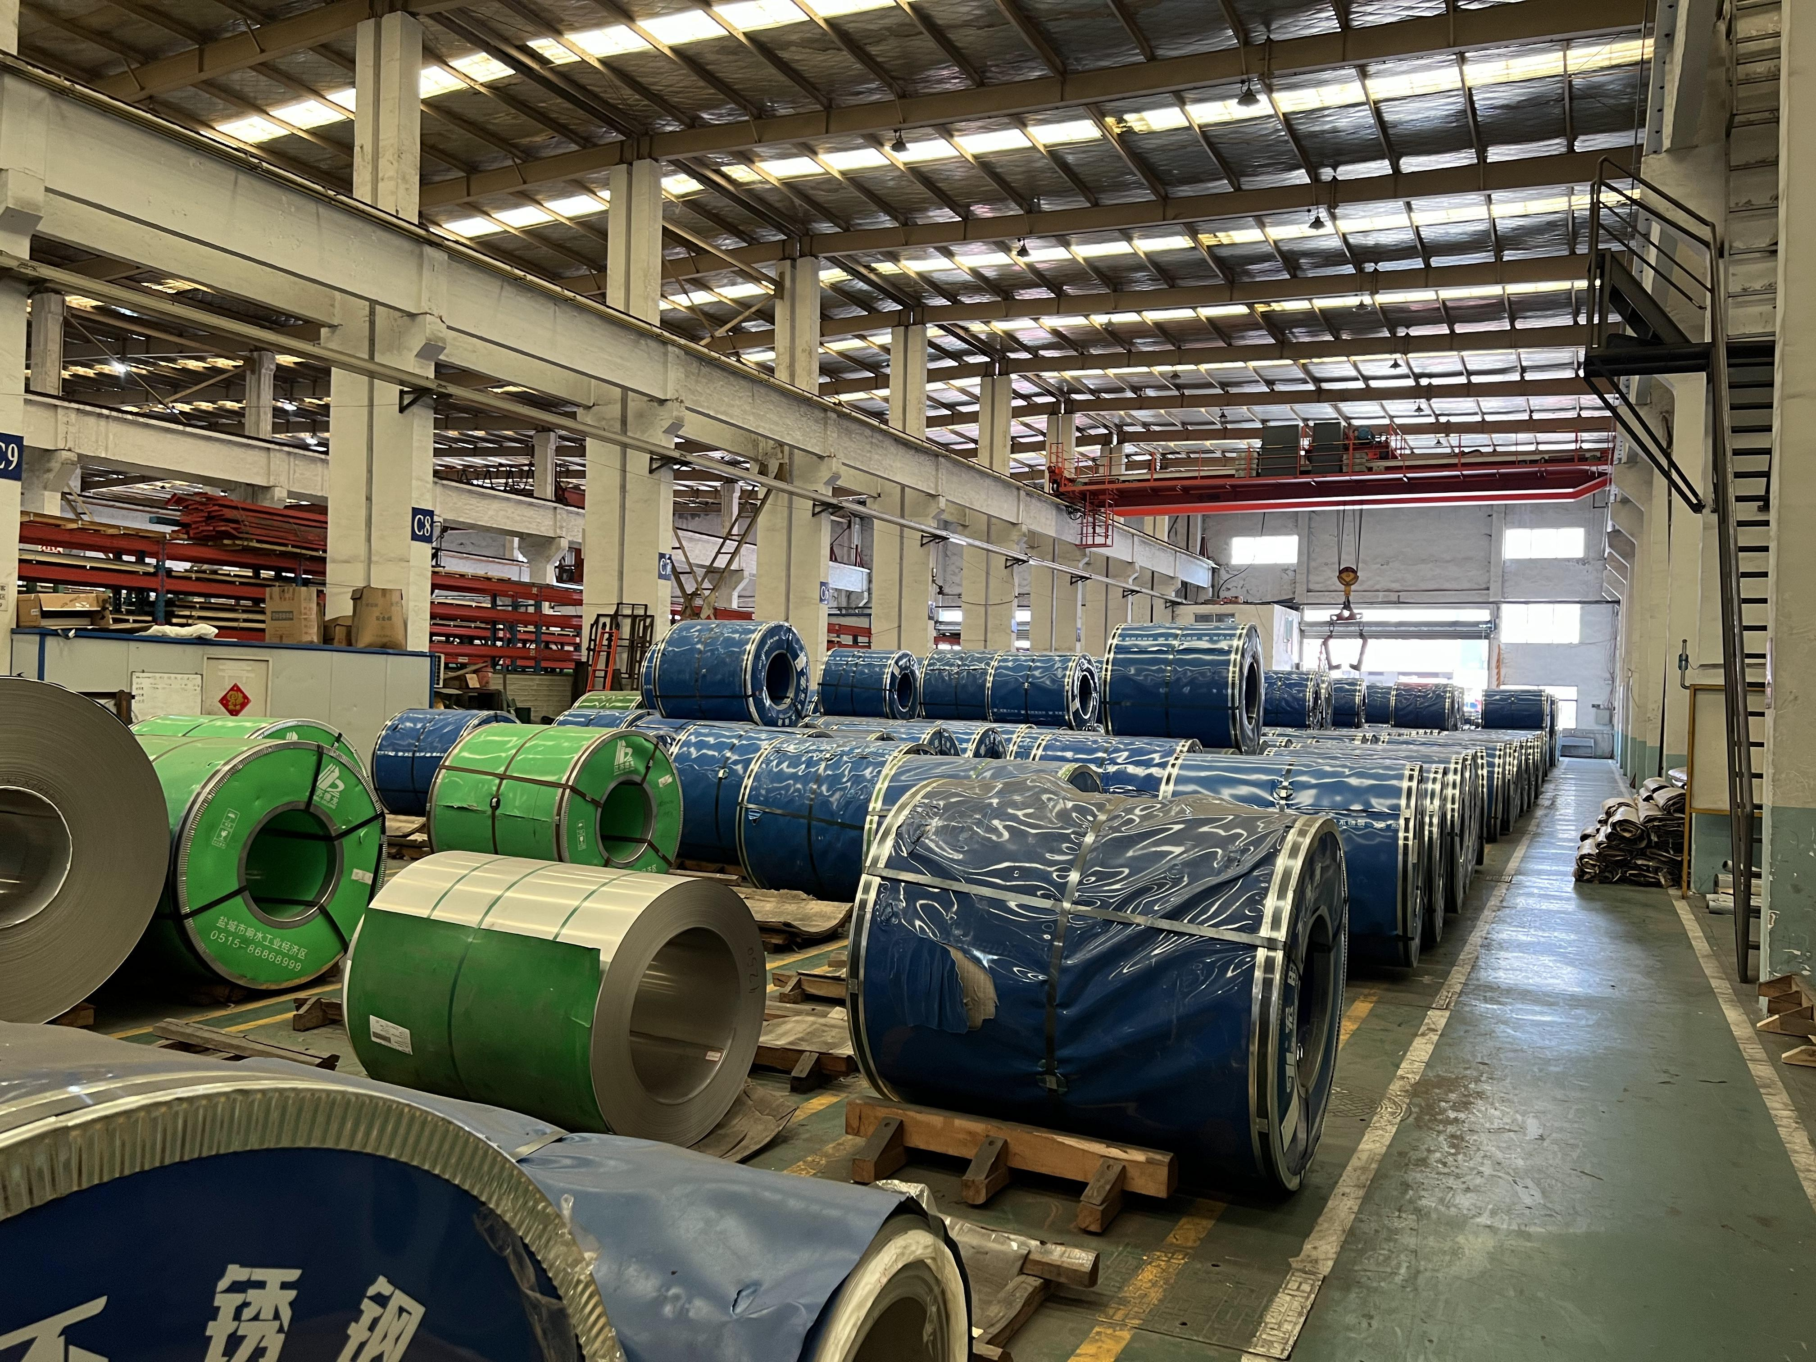
Our main products including carbon steel plate, carbon steel coil, carbon steel pipe, carbon steel bar, galvanized steel plate, galvanized steel coil, galvanized steel pipe, galvanized steel bar, stainless steel pipe, stainless steel plate, stainless steel bar, stainless steel coil, aluminum plate, aluminum coil, aluminum pipe, aluminum bar, etc. Our company has the most advanced production equipment which guarantees the most advantageous product quality. All the steel materials operated by our company are in line with the national standards, and the original material list of the steel factory is attached.

Slide 5
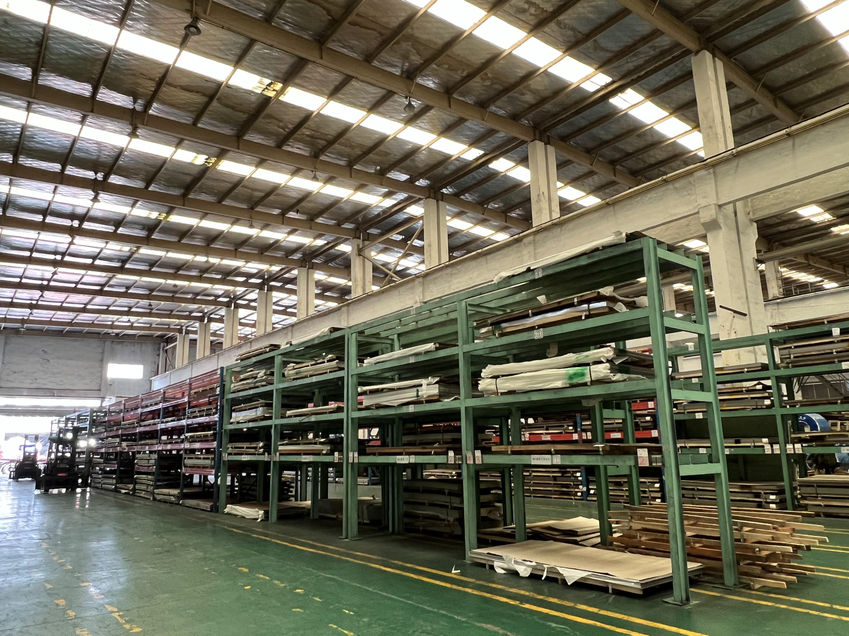
With internationally advanced production equipment, hot rolling mills, cold rolling mills, etc. Products are widely used in electrical, chemical, pipeline, machinery manufacturing, automobiles, ships, aerospace, construction, and other industries. The factory can produce according to GB, ASTM, DIN, and EN standards.
Qingdao Puye Steel now has grown to a leading supplier in the Galvanized steel, hot rolled/cold rolled carbon steel, and stainless industry. Based on highly quality products and best service , we have develop clients all round the world ,our products are widely used in industry in USA, Germany , India, Iran, Dubai, Iraq, Vietnam, Ireland, Singapore, etc. Our company can order various non-standard specifications on behalf of customers, special material steel products, can be delivered to your door, ordering quickly.

Slide 6
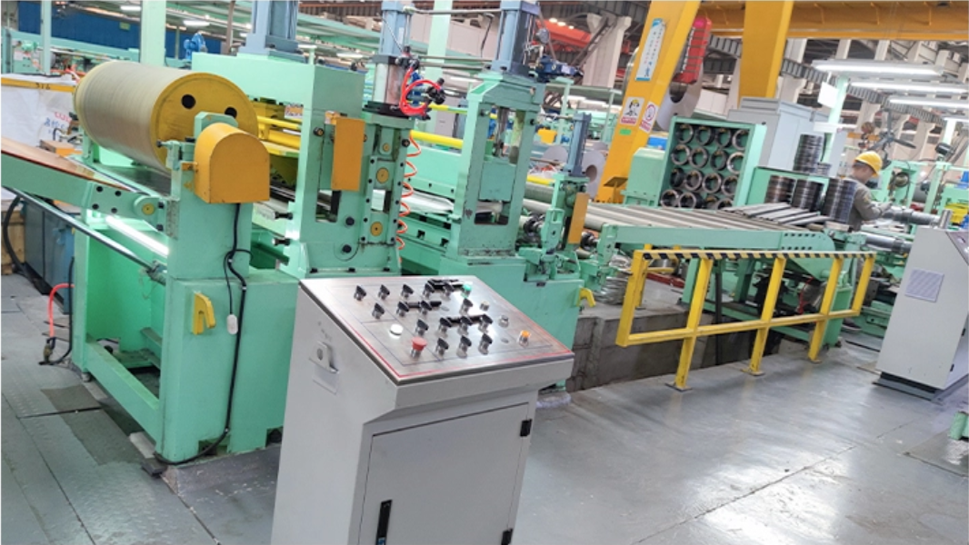
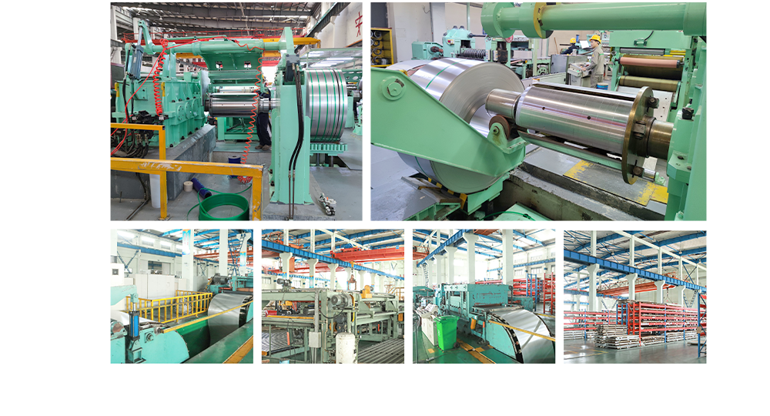
Workshop show

Slide 7
Stainless Steel

Slide 8
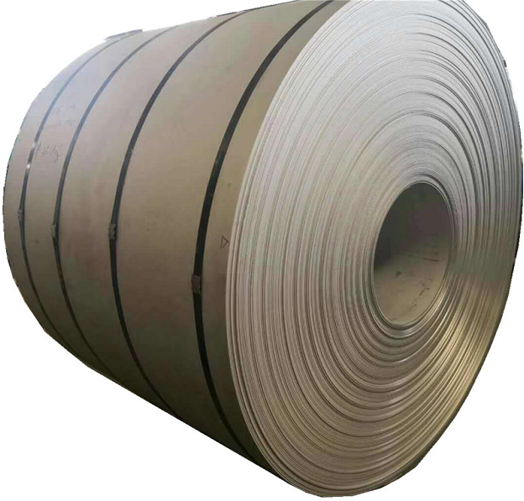
Stainless Steel Coil Hot Rolled
Steel Grade | 201, 304, 316, 316L, 410, 430, etc
Standard | JIS, AISI, ASTM, DIN, TUV,BV,SUS,etc
Thickness | 3.0 - 16mm
Width | 600mm - 2500mm
Length | 2000/2438/3048mm
Color | Golden, Black , Sapphire Blue, Brown, Rose gold, Bronze, Purple, gray, silver, Champagne, violet, blue diamond, etc
Application | Interior/exterior decoration, elevator decoration, kitchen equipment, ceiling, cabinet, kitchen sink
Lead time | 7 to 25 working days after the receipt of 30% deposit
Payment terms | 30%TT for deposit, 70% balance before shipment or LC at sight
Packing | Wooden pallet or according to customer's request

Slide 9
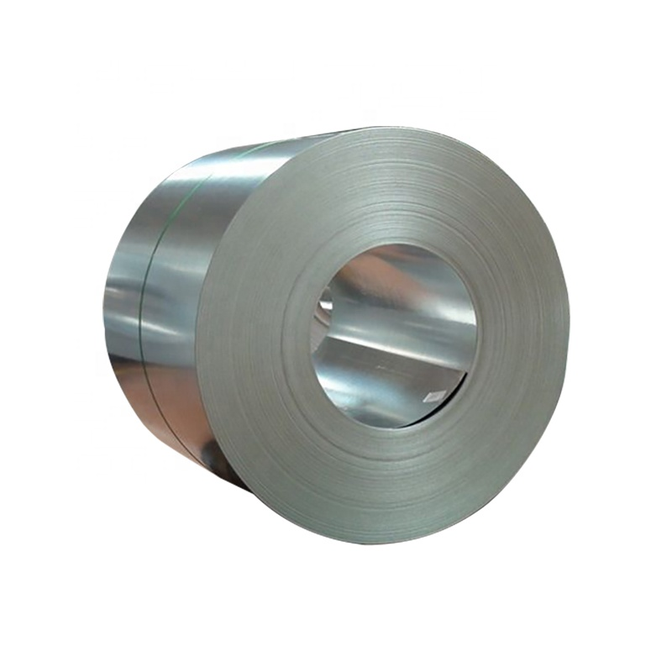
Stainless Steel Coil Cold Rolled
Grade | 201, 304, 316, 316L, 410, 430, etc
Standard | JIS, AISI, ASTM, DIN, TUV,BV,SUS,etc
Thickness | 0.25 - 3mm
Width | 600mm - 1500mm
Length | 2000/2438/3048mm
Color | Golden, Black , Sapphire Blue, Brown, Rose gold, Bronze, Purple, gray, silver, Champagne, violet, blue diamond, etc
Application | Interior/exterior/architectural/bathroom decoration, elevator decoration, hotel decoration, kitchen equipment, ceiling, cabinet,
 | kitchen sink, advertising nameplate
Lead time | 7 to 25 working days after the receipt of 30% deposit
Payment terms | 30%TT for deposit, 70% balance before shipment or LC at sight
Packing | Wooden pallet or according to customer's request

Slide 10

Stainless Steel Plate
Steel Grade | 201, 202, 301, 302, 303, 304, 304L, 304H, 310S, 316, 316L, 317L, 321,310S 309S, 410, 410S,420, 430, 431, 440A,904L
Length | as required
Width | 45mm-2200mm, As Your Request
Thickness | 0.15mm-180mm, as Your Request
Standard | AISI,ASTM,DIN,JIS,GB,JIS,SUS,EN,etc
Technique | Hot rolled / cold rolled
Surface Treatment | NO.1 BA 2B 2D 4K 6K 8K NO.4 HL SB PVC coated Polish Mirror Embossed Smooth Bright finish Black
Thickness Tolerance | ±0.01mm
Application | Machinery, electric power, textiles, rubber, food, medical equipment, aviation, petroleum ect.
MOQ | 1 ton
Export Packing | Standard Export Seaworthy Package.Suit for all kinds of transport,or as required

Slide 11
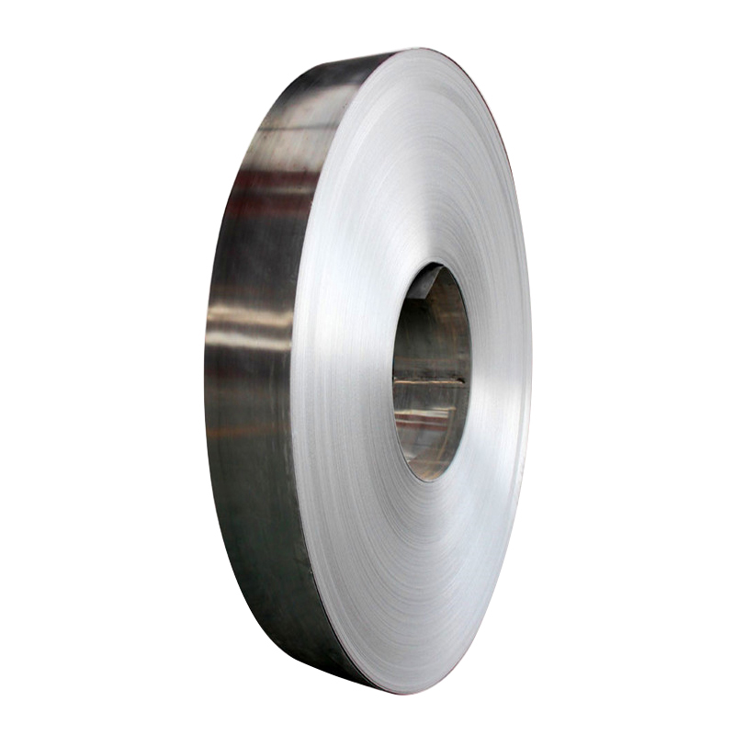
Stainless Steel Strip
Name | Stainless steel strip
Grade | 201, 304, 316, 316L, 410, 430, etc
Standard | JIS, AISI, ASTM, DIN, TUV,BV,SUS,etc
Thickness | 0.25 - 3mm
Width | 600mm - 1500mm
Length | 2000/2438/3048mm
Size | 1000mm*2000mm, 1219mm*2438mm, 1219mm*3048mm, or as required
Color | Golden, Black , Sapphire Blue, Brown, Rose gold, Bronze, Purple, gray, silver, Champagne, violet, blue diamond, etc
Application | architectural decoration, elevator decoration, kitchen equipment, ceiling, cabinet, kitchen sink
Lead time | 7 to 25 working days after the receipt of 30% deposit
Payment terms | T/T, 30% deposit, 70% balance before shipment or LC at sight
Packing | Wooden pallet or according to customer's request

Slide 12
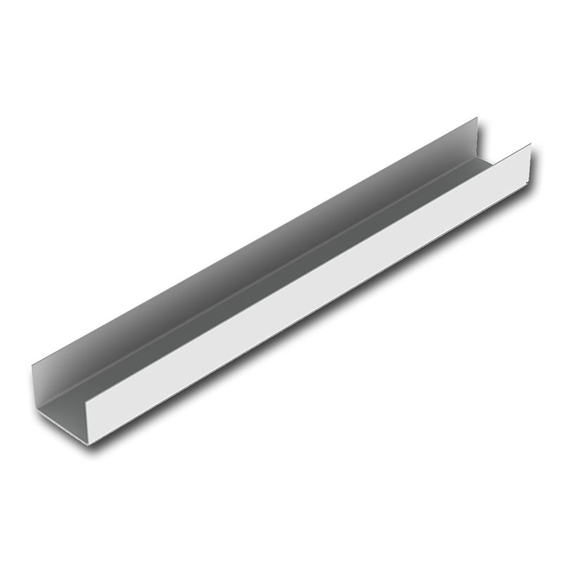
stainless steel channel
Material | 201, 202, 301, 302, 304, 304L, 310S, 316, 316L, 321, 430, 430A, 309S, 2205, 2507, 2520, 430 , 410, 440, 904Lect, Or Customized
Surface | BA, 2B, 2D, 4K, 6K, 8K, NO.4, HL, SB, Embossed
Thinckness | 5#-150#
Length | 1000mm~8000mm or customized
Payment terms | L/C T/T (30%DEPOSIT)
Stock or not | enough stock
Sample | Provided Freely
Container Size | 20ft GP: 5898mm(Length)x2352mm(Width)x2393mm(High)
 | 40ft GP: 12032mm(Length)x2352mm(Width)x2393mm(High)
 | 40ft HC: 12032mm(Lengh)x2352mm(Width)x2698mm(High)
Delivery time | Fast delievery in 7 days,up to order quantity

Slide 13
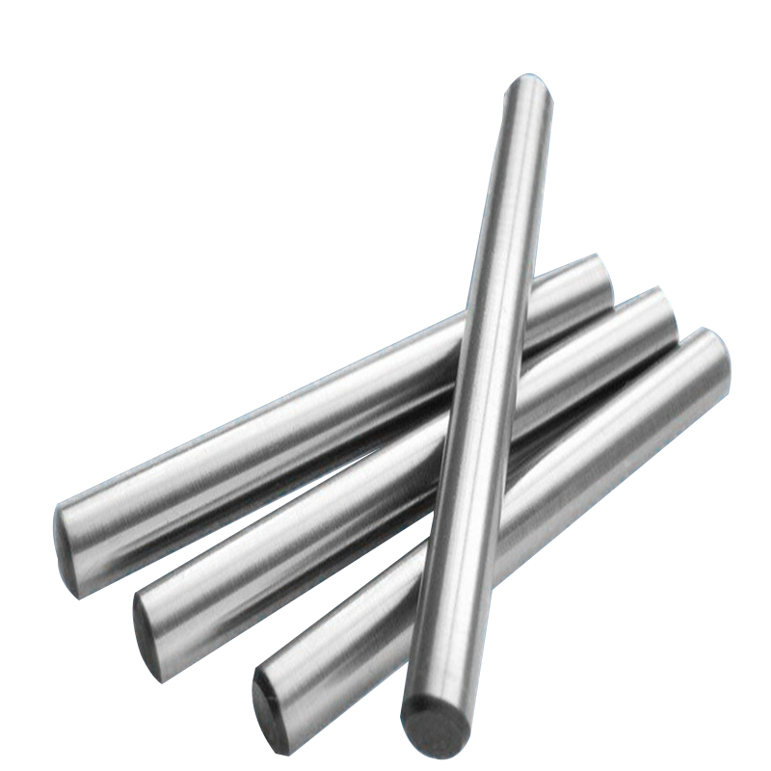
Stainless Steel Bars
Steel Grade | 201, 202 , 304 , 304L , 304H , 309, 309S , 310 etc.
Surface Finish | Polish bright black
Standard | JIS/SUS/GB/DIN/ASTM/AISI/EN
Technique | Cold Rolled; Hot Rolled
Diameter | 3-480mm
Length | 3000mm, 4000mm, 6000mm,12000mm,or as required.
Application | Widely used in petroleum, chemical industry, construction, energy, machinery, boiler fields.
Lead Time | 7-15 working days after the receipt of 30% deposit
Payment Terms | 30% TT for deposit,70% TT /70% LC at sight balance before shipment
Price Terms | FOB, EXW, CIF, CFR
Packing | Standard Seaworthy Package or according to customer's requirements
Container Size | 0ft GP:5898mm(Length)x2352mm(Width)x2393mm(High) 24-26CBM40ft
 | GP:12032mm(Length)x2352mm(Width)x2393mm(High) 54CBM
 | 40ft HC:12032mm(Length)x2352mm(Width)x2698mm(High) 68CBM

Slide 14
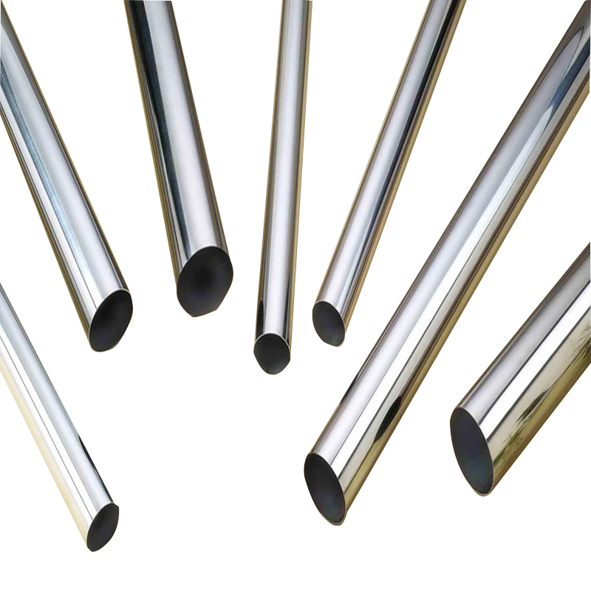
Stainless Steel Pipe Tube
Technology | Hot Rolled Industrial Stainless Steel Tube
 | Cold Rolled Decorative Stainless Steel Pipe
Material | 201, 202, 301, 304, 304L, 310S, 316, 316L, 321, 430, 430A, 309S, 2205, 2507, 2520, 430 , 410, 440, 904Lect, Or Customized
Length | 1-12 m
Size | 10x10-100x100 mm
Standard | ASTM, JIS, GB, AISI, DIN, BS,EN
Certifications | ISO 9001 BV SGS
Packing | Industry standard packaging or according to client's requirement
Payment terms | 30%T/T in advance, the balance against the B/L copy
Stock or not | 5000 tons per month
Sample | Provided Freely
Container Size | 20ft GP: 5898mm(Length)x2352mm(Width)x2393mm(High)
 | 40ft GP: 12032mm(Length)x2352mm(Width)x2393mm(High)
 | 40ft HC: 12032mm(Lengh)x2352mm(Width)x2698mm(High)
Delivery time | Fast delievery in 7 days,up to order quantity
Note | We can produce other sizes as the customers' requirement.

Slide 15
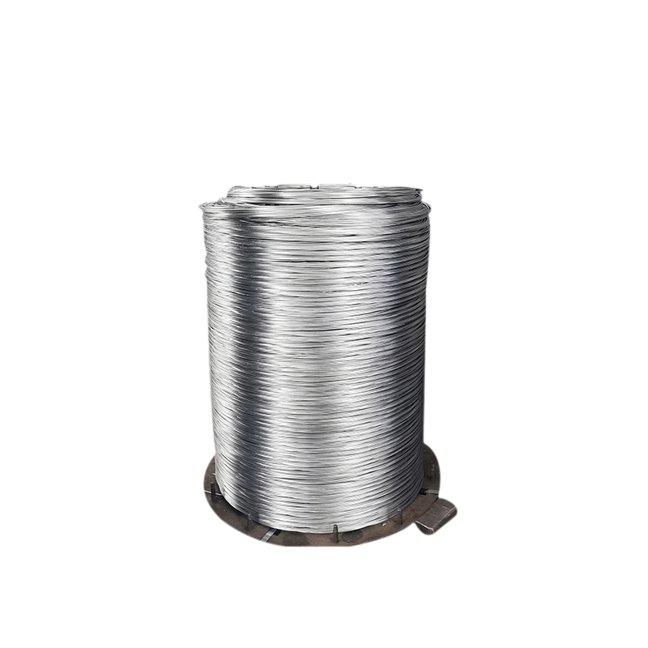
stainless steel welding wire
Standard | AiSi
Grade | 300 200 400 Series
Length | as your requirement
Application | instruction
C Content (%) | ISO
Si Content (%) | Standard
Place of Origin | China
Model Number | 201 304 430 316
Tolerance | ±1%
Processing Service | Welding, Cutting
Steel Grade | 301, 304, 304L, 310S, 316L, 410
Surface Finish | 2B
Delivery Time | 15-21 days
Product Name | Stainless Seel Wire
Material | 201/301/304/309/310/316/316L
Type | Soft
Surface | Bright Finish
Usage | Industry Machine
MOQ | 100 kgs
Diameter | 0.1-50mm
Packing | Standard Seaworthy Package
Size | 0.15-7.5mm
Construction | 7X19 Ect

Slide 16
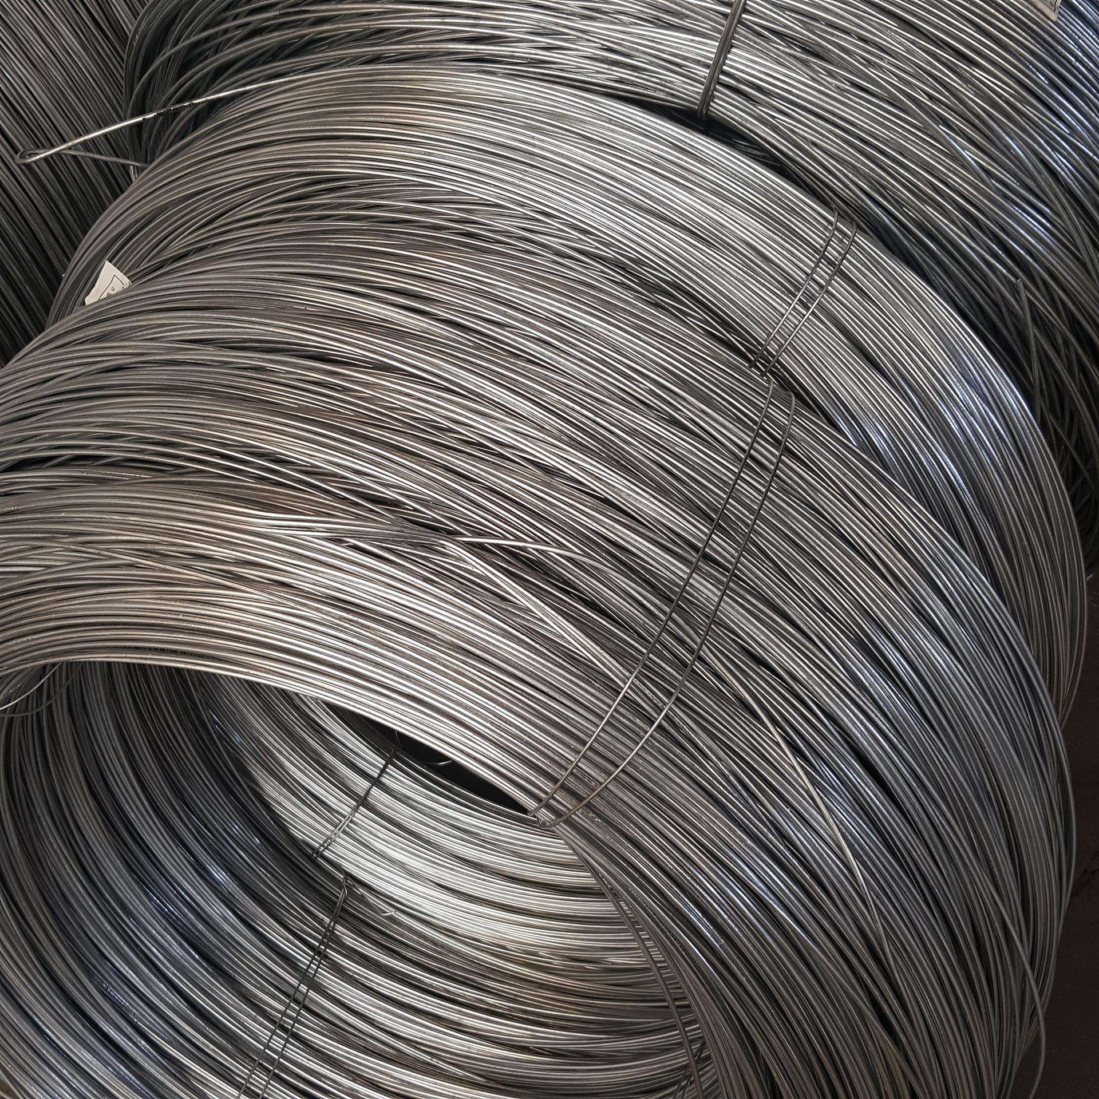
Stainless Steel Wire 不锈钢丝
Product Name | Stainless Steel Wire
Material | 201, 202, 301, 302, 304, 304L, 310S, 316, 316L, 321, 430, 430A, 309S, 2205, 2507, 2520, 430 , 410, 440, 904Lect, Or Customized
Length | As customer’s demands
Diameter | 0.3~6.0mm ,as customer’s demands
Surface Finsh | Coated
Certifications | ISO 9001 BV SGS
Packing | Industry standard packaging or according to client's requirement
Brand | TISCO,ZPSS,Baosteel,POSCO,LISCO,YUSCO,Ansteel, QPSS,JISCO,HXSCO,
 | Chengde,Yongjin,Tsingshan,Shouyang,HW
Payment terms | 30%T/T in advance, the balance against the B/L copy
Delivery time | Fast delievery in 7 days,up to order quantity
Warehose Stcok | 5000 tons per month

Slide 17
Carbon Steel

Slide 18
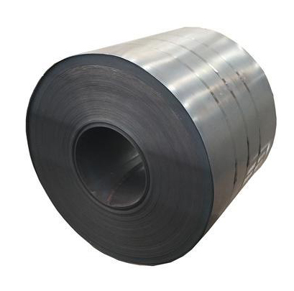
Carbon Steel Coil
Length | 1000-12000mm(All Sizes Can be customzied)
Width | 600mm-1500mm or customized
Thickness | 0.1mm~30mm
Standard | ASTM, JIS, EN
Technique | Hot rolled / Cold rolled
Thickness Tolerance | ±0.01mm
Material | Q195,Q215 A,Q215 B,Q215AF,Q215BF,Q235 A,Q235 B,Q235 C,Q235D,Q235BF,
MOQ | 1 ton

Slide 19
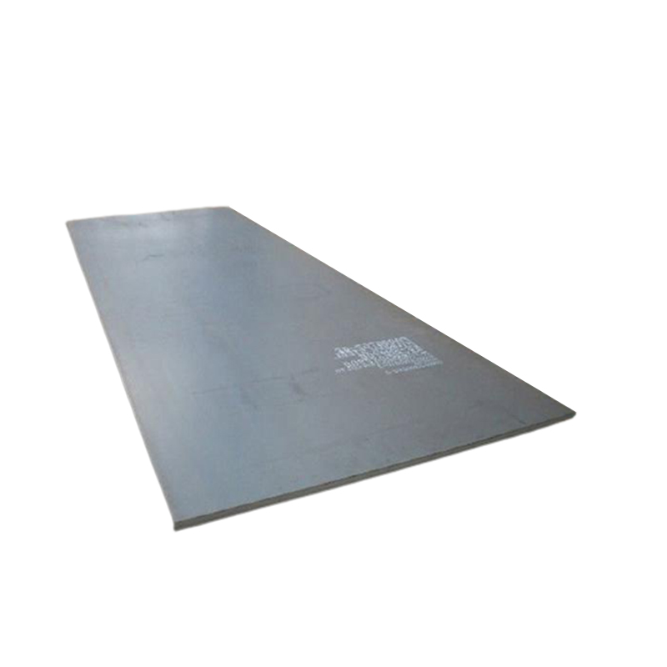
Carbon Steel Sheet
Thickness | 4-60mm
Width | 1250-2500mm
Length | 1000-12000mm
Place of origin | Jiangsu, China
Surface | Black
Quality test | we can offer MTC(mill test certificate)
Payment terms | L/C in sight， T/T (30%DEPOSIT)
Iventory | In stock
Sample | Provided Freely
Container Size | 20ft GP: 5898mm(Length)x2352mm(Width)x2393mm(High)
 | 40ft GP: 12032mm(Length)x2352mm(Width)x2393mm(High)
 | 40ft HC: 12032mm(Lengh)x2352mm(Width)x2698mm(High)
Delivery time | Within 7-10 Working Days

Slide 20
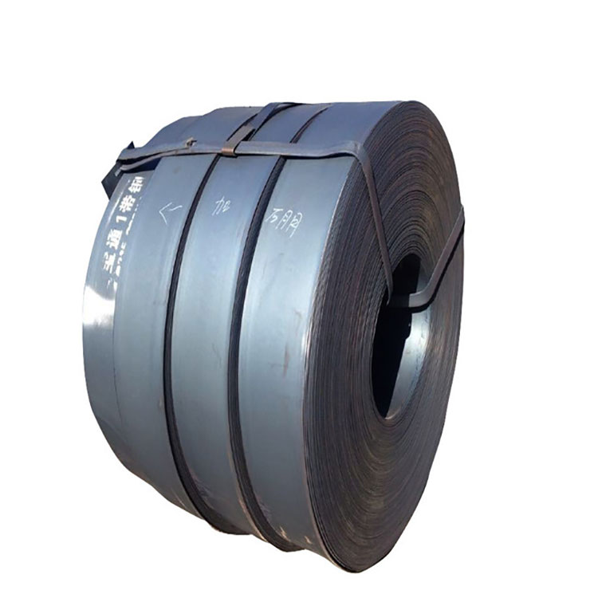
Carbon Steel Strip
Product Name | Carbon steel strip
Width | 20mm-600mm or customized
Thickness | 0.2mm~3.0mm / 3.0mm~16mm
Standard | ASTM, JIS, EN
Technique | Hot rolled / Cold rolled
Surface Treatment | 2B/BA/HL/NO.4/8K/Embossed/Gold/Rose Gold/Black Gold
Thickness Tolerance | ±0.01mm
Material | Q195,Q215 A,Q215 B,Q215AF,Q215BF,Q235 A,Q235 B,Q235 C,Q235D,Q235BF,
MOQ | 1 ton
Shipment Time | Within 7 workdays for less 20tons and 10days for less 50tons after receiving deposit or L/C, more 50tons need about 20days.
Export Packing | Waterproof paper, and steel strip packed.
Capacity | 250,000 tons/year

Slide 21
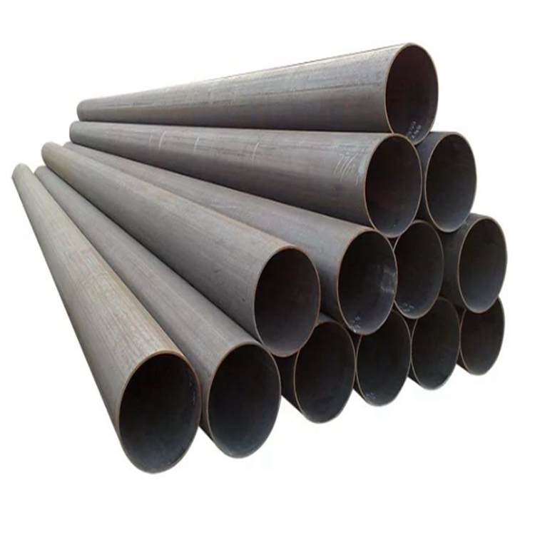
Carbon Steel Pipe & Tube
Length | 12m, 6m, 6.4m
Thickness | 0.6 - 20 mm
Standard | ASTM JIS EN BSI
Technique | ERW
Surface Treatment | HOT ROLLED
Thickness Tolerance | ±0.01mm
Material | carbon steel
MOQ | 1 ton
Shipment Time | Within 7 workdays for less 20tons and 10days for less 50tons after receiving deposit or L/C, more 50tons need about 20days.
Export Packing | Waterproof paper, and steel strip packed.

Slide 22
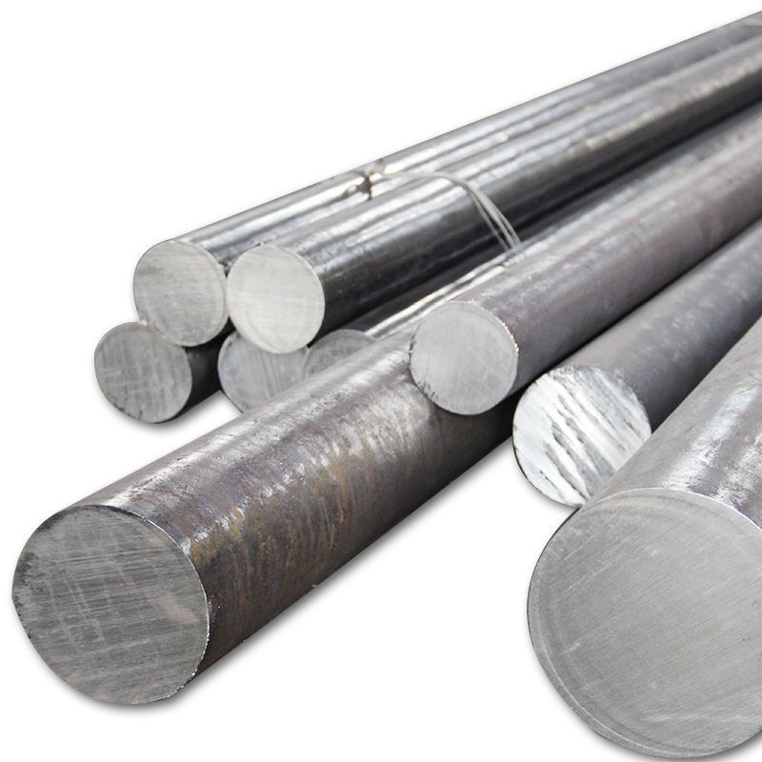
Carbon Steel Bar
Prdouct Name | Carbon Steel Bar
Shape | Round,Square,Flat,Rectangle,etc.
Material | Carbon steel :Q195-Q420 Series,SS400-SS540 Series,S235JR-S355JR Series,ST Series,A36-A992 Series,Gr50 Series,etc.
Surface | Mild steel plain finish, hot dip galvanized, color coated, ect.
Size Tolerance | ±3%
Processing method | Bending, Welding, Decoiling, Cutting, Punching, Polishing or as customer's request
Size | OD from 10 - 400mm, length from 1m-12m or according to customer's special request
Technology | Hot roll, cold roll, cold drawn, ect.
Trade Term | FOB,CIF,CFR,EXW,etc.
Price Term | T/T,L/C,Western Union,Paypal,Apple Pay,Google Pay,D/A,D/P,MoneyGram
Lead time | Small batch can be in 7 days, depending on the quantity
Certificate | ISO9001

Slide 23
Galvanized Steel

Slide 24
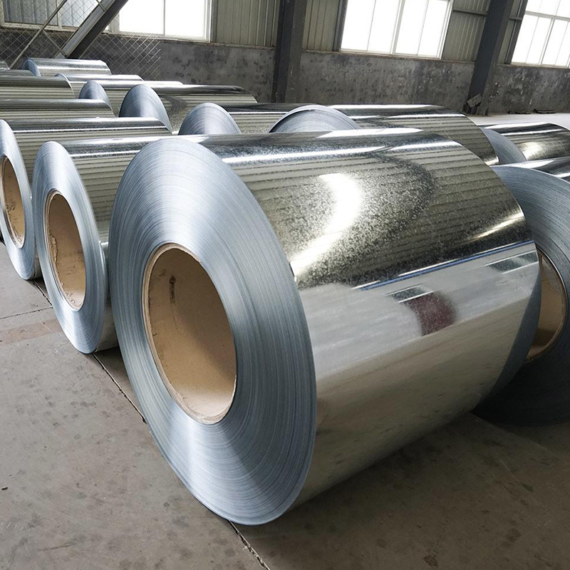
Galvanized Steel Coil
Name | Galvanized Steel Coil/Sheet
Thick | 0.12 ~6.0 mm
Width | 600-1500 mm
Zinc Coating | 30~600G/M²
Coil ID | 508 / 610MM
Payment terms | L/C T/T (30%DEPOSIT)
Stock or not | enough stock
Sample | Provided Freely
Container Size | 20ft GP: 5898mm(Length)x2352mm(Width)x2393mm(High)
 | 40ft GP: 12032mm(Length)x2352mm(Width)x2393mm(High)
 | 40ft HC: 12032mm(Lengh)x2352mm(Width)x2698mm(High)
Delivery time | Within 7-10 Working Days

Slide 25
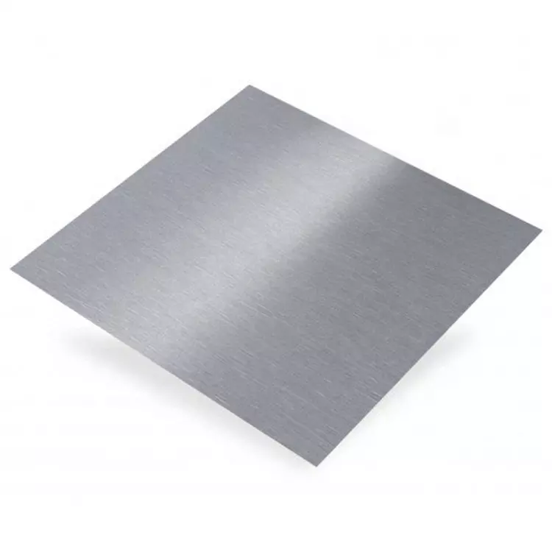
Galvanized Steel Plate
Length | As customers' requirement
Width | 600-1500mm
Thickness | 0.13-1.5mm
Standard | AISI,ASTM,DIN,JIS,GB,JIS,SUS,EN,etc
Technique | Hot Rolled
Surface Treatment | bright
Thickness Tolerance | ±0.01mm
Material | SPCC,SPCD,SPCE,Q195,DC01,DC02,DC03,DC04,ST12
Application | Building,Construction Etc
MOQ | 1 ton
Shipment Time | Within 7 workdays for less 20tons and 10days for less 50tons after receiving deposit or L/C, more 50tons need about 20days.
Export Packing | Standard Export Seaworthy Package.Suit for all kinds of transport,or as required
Capacity | 250,000 tons/year

Slide 26
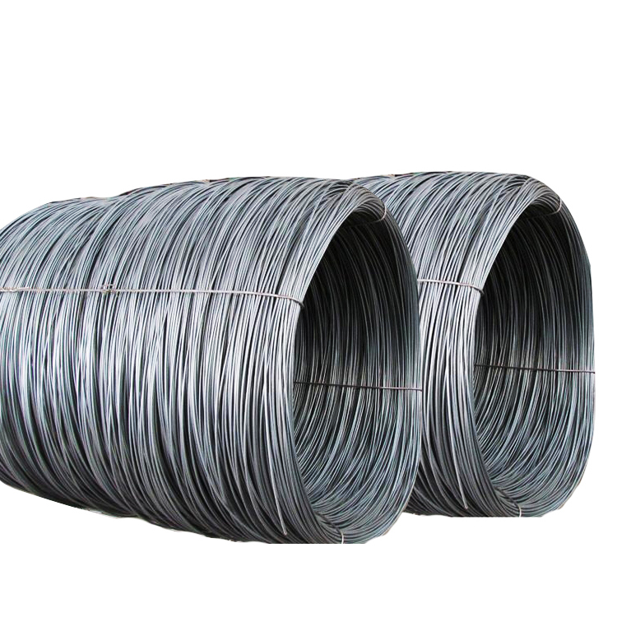
Galvanized Steel Wire
Product Name | Professional Manufacturer High Tensile High Carbon Galvanized Steel Wire For Armouring Cable
Standard | AiSi, BS, JIS, GB, ASTM, DIN, AISI
Diameter | 0.3mm-120mm
Material | 45#,60#,72A,82B steel rod,304 316 steel rod.
Brand Name | Bright
Length | 100m,500m,1000m,2000m or customer requirement
Packing | Canton box,plastic reel,wooden reel,steel reel,wooden box
MOQ | 2 TONS

Slide 27
PPGI Coil

Slide 28
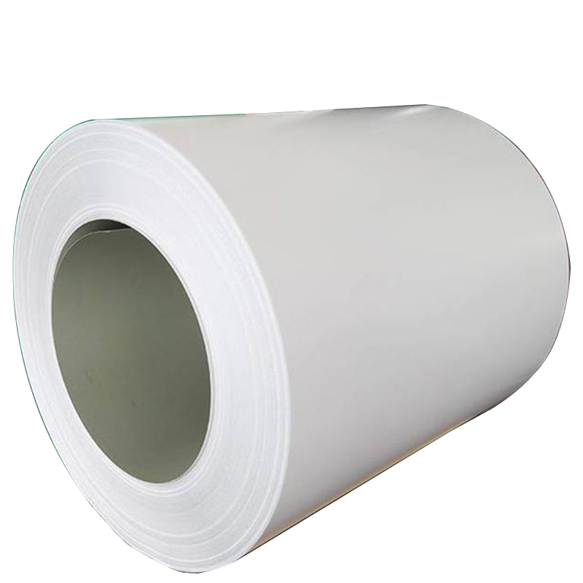
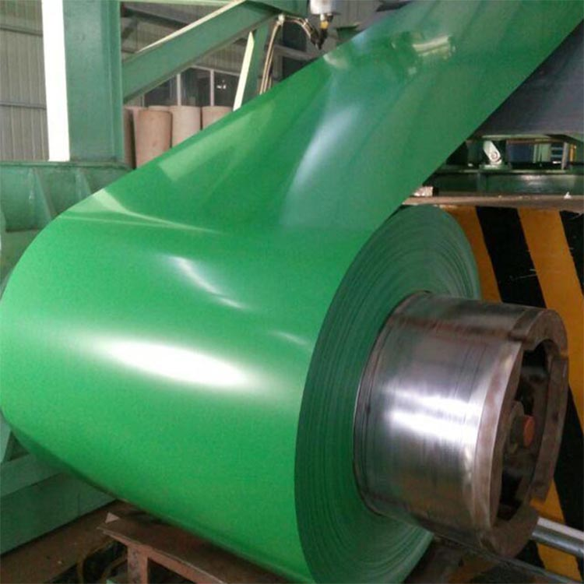
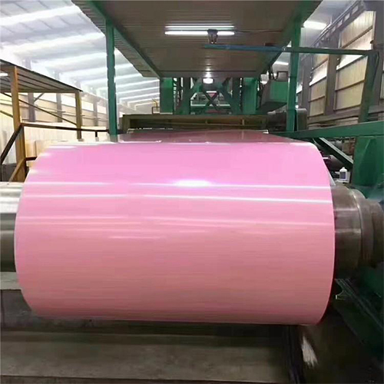
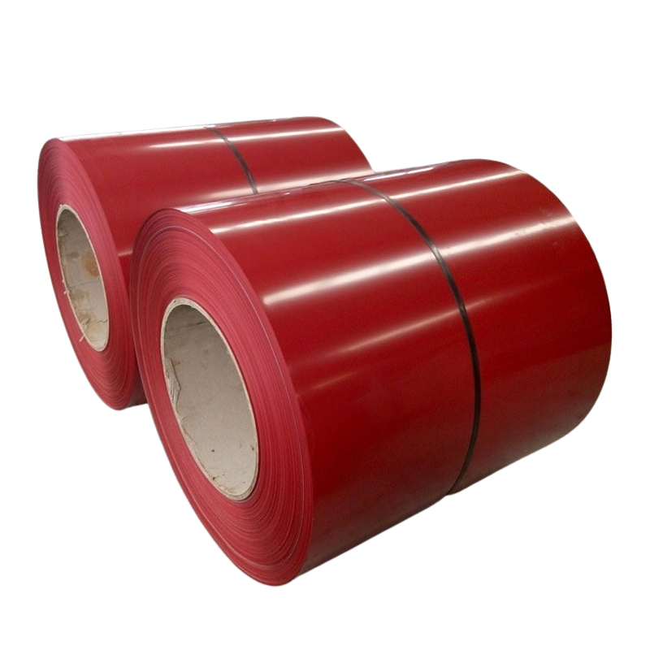
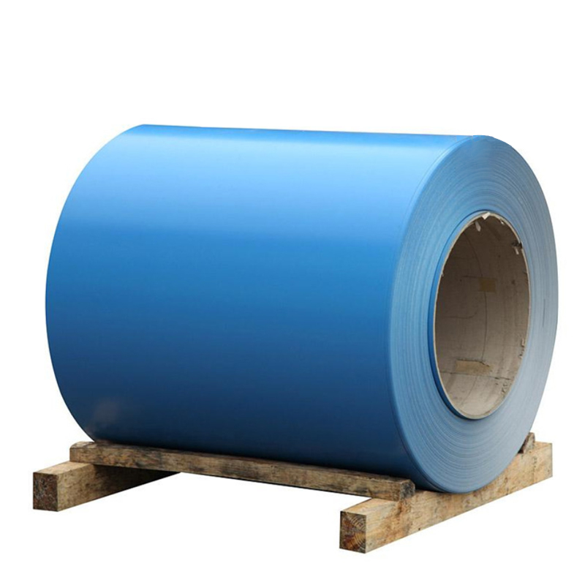
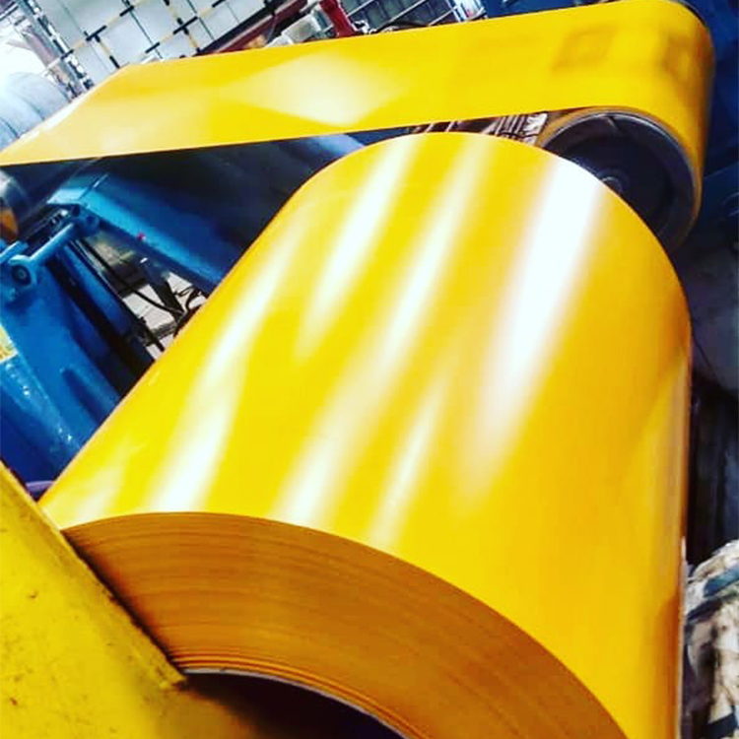
PPGi Coil
Product | PPGi Coil (Pre-Painted Galvanized)
Technology | Pre galvanized, hot dip galvanized, color coated, ect.
Color | Ral color, can be customized according to customer needs
Width | 1000~1500mm or as customer's requirements
Thickness | Cold rolled:0.2~4.0mm
 | Hot rolled:4mm~300mm
Length | 100mm to 12000mm or as customer's request
Zinc coating | 60g/m²-600g/m²-
Steel Grade | SPCC,SPCD,SPCE,ST12-15,DC01-06,Q195A-Q235A,Q195AF-Q235AF,Q295A(B)-Q345A(B)
Standards | AISI ASTM JIS SUS DIN GB
Certifications | ISO 9001
Packing | Industry standard packaging or according to client's requirement
Brand | TISCO,ZPSS,Baosteel,POSCO,LISCO,YUSCO,Ansteel, QPSS,JISCO,HXSCO,
 | Chengde,Yongjin,Tsingshan,Shouyang,HW
Payment | T/T,L/C,Western Union,Paypal,Apple Pay,Google Pay,D/A,D/P,MoneyGram
Delivery time | Up to order quantity

Slide 29
Aluminum

Slide 30
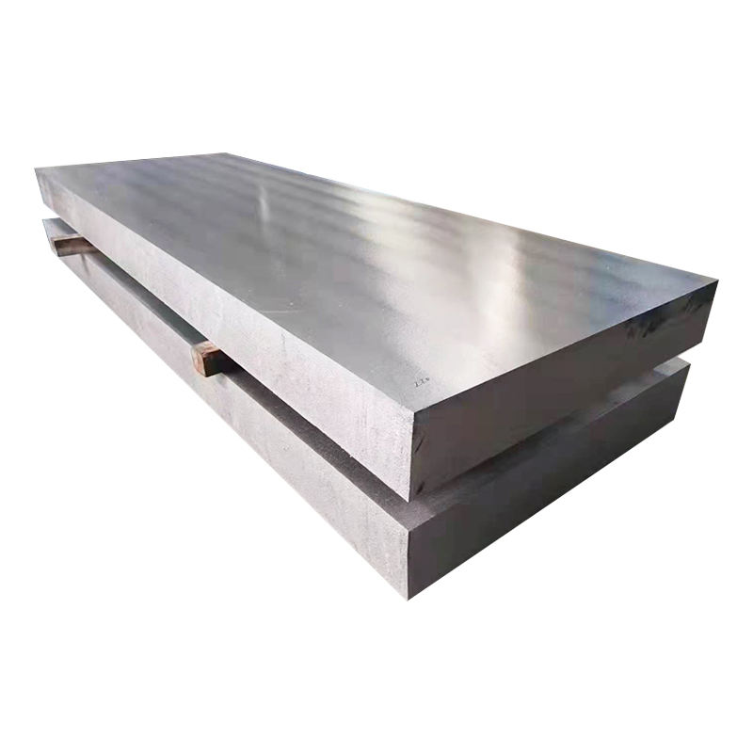
Aluminum/Aluminium Plate & Sheet
Model | Aluminum/AluminiumSheet/Plate
Standard | GB/T3190-2008,GB/T3880-2006,ASTM B209,JIS H4000-2006,etc
MaterialGrade | Hot Sales: 1060, 2024, 5052, 6061, 6063, 7075 1000 series: 1050, 1060, 1070, 1080, 1100, 1435, etc 2000 series: 2011, 2014, 2017, 2024, etc 3000 series: 3002, 3003, 3104, 3204, 3030, etc 5000 series: 5005, 5025, 5040, 5056, 5083, etc 6000 series: 6101, 6003, 6061, 6063, 6020, 6201, 6262, 6082, etc 7000 series: 7003, 7005, 7050, 7075, etc
Size | Thickness: 0.01mm -200mmWidth: 100-2000mmLength:2000mm,2440mm,6000mm,or as required.
Quality control | Mill Test Certification is supplied with shipment,Third Part Inspection is acceptable.
Surface | Bright,polished,hair line,brush,sand blast,checkered,embossed,etching,etc
Trade terms | Price term: Ex-Work,FOB,CNF,CFR,etcPayment Term: TT,L/C,western Union,etc
MOQ | 1 TON
Application | 1)Further making utensil.2)Solar reflective film3)The appearance of the building4)Interior decorating: ceilings, walls, etc.5)Furniture cabinets6)Elevator decoraction7)Signs, nameplate, bags making.8)Decorated inside and outside the car9)Household appliances: refrigerators,microwave ovens,audio equipment,etc.10)The consumer electronics: mobile phones, digital cameras, MP3, U disk, etc.

Slide 31
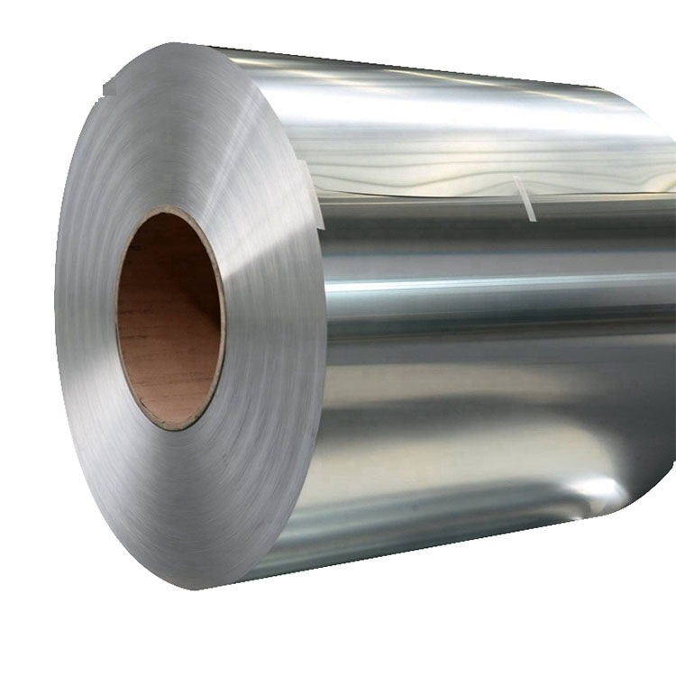
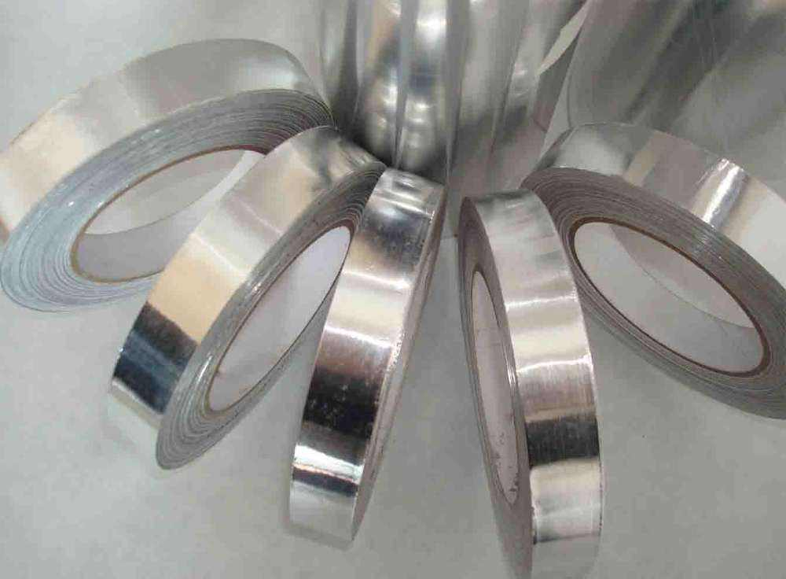
Aluminum/Aluminium Coil & Strip
Model | Aluminum/AluminiumCoil & Strip
Standard | GB/T3190-2008,GB/T3880-2006,ASTM B209,JIS H4000-2006,etc
MaterialGrade | Hot Sales: 1060, 2024, 5052, 6061, 6063, 7075 1000 series: 1050, 1060, 1070, 1080, 1100, 1435, etc 2000 series: 2011, 2014, 2017, 2024, etc 3000 series: 3002, 3003, 3104, 3204, 3030, etc 5000 series: 5005, 5025, 5040, 5056, 5083, etc 6000 series: 6101, 6003, 6061, 6063, 6020, 6201, 6262, 6082, etc 7000 series: 7003, 7005, 7050, 7075, etc
Size | Thickness: 0.01mm-4mmWidth: 10mm-1000mmLength:2000mm,2440mm,6000mm,or as required.
Quality control | Mill Test Certification is supplied with shipment,Third Part Inspection is acceptable.
Surface | Bright,polished,hair line,brush,sand blast,checkered,embossed,etching,etc
Trade terms | Price term: Ex-Work,FOB,CNF,CFR,etcPayment Term: TT,L/C,western Union,etc
MOQ | 1 TON
Application | 1)Further making utensil.2)Solar reflective film3)The appearance of the building4)Interior decorating: ceilings, walls, etc.5)Furniture cabinets6)Elevator decoraction7)Signs, nameplate, bags making.8)Decorated inside and outside the car9)Household appliances: refrigerators,microwave ovens,audio equipment,etc.10)The consumer electronics: mobile phones, digital cameras, MP3, U disk, etc.

Slide 32
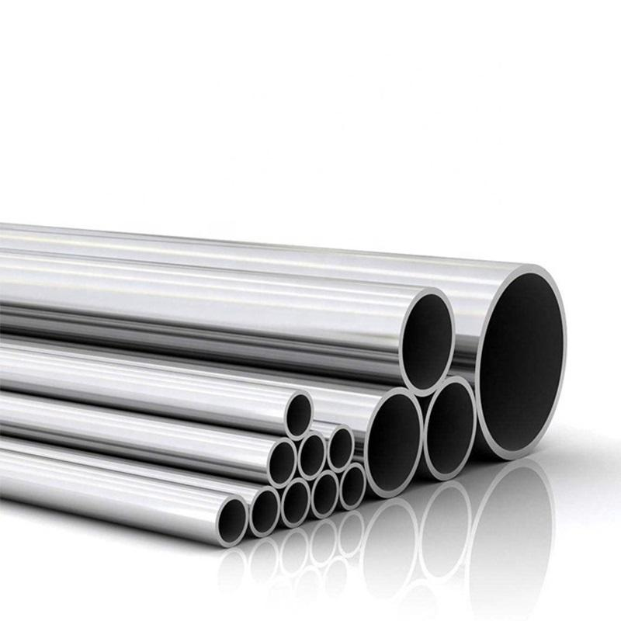
Aluminum/Aluminium Tube & Pipe
Model | Aluminum/Aluminium Tube& Pipe
Material Grade | Hot Sales: 1060, 2024, 5052, 6061, 6063, 7075 1000 series: 1050, 1060, 1070, 1080, 1100, 1435, etc 2000 series: 2011, 2014, 2017, 2024, etc 3000 series: 3002, 3003, 3104, 3204, 3030, etc 5000 series: 5005, 5025, 5040, 5056, 5083, etc 6000 series: 6101, 6003, 6061, 6063, 6020, 6201, 6262, 6082, etc 7000 series: 7003, 7005, 7050, 7075, etc
Size | Outer Diameter: 3-250mmWall Thickness: 0.3-50mmLength: 10mm-6000mm
Standards | ASTM, ASME, EN, JIS, DIN, GB/T, etc
Surface treatment | Mill finished, anodized, powder coating, Sand blast, etc
Surface colors | Bright, polished, hair line, brush, sand blast, checkered ,embossed, etching, etc
Status | T4 T5 T6 or other special status
Certificate | ISO, SGS, BV and so on.
MOQ | 1 ton
Application | 1)Further making utensil.2)Solar reflective film3)The appearance of the building4)Interior decorating: ceilings, walls, etc.5)Furniture cabinets6)Elevator decoraction7)Signs, nameplate, bags making.8)Decorated inside and outside the car9)Household appliances: refrigerators,microwave ovens,audio equipment,etc.10)The consumer electronics: mobile phones, digital cameras, MP3, U disk, etc.

Slide 33
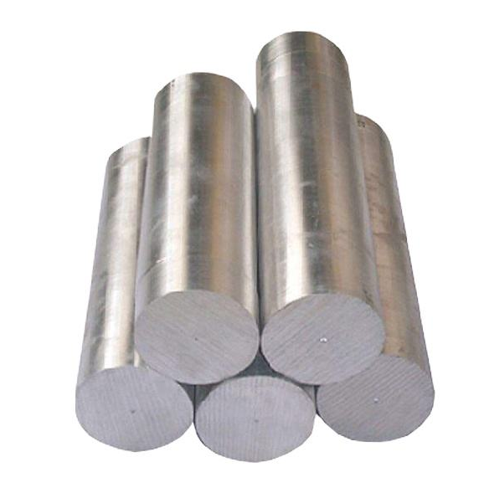
Aluminum/Aluminium Rod & Bar
Model | Aluminum/Aluminium Tube& Pipe
Material Grade | Hot Sales: 1060, 2024, 5052, 6061, 6063, 7075 1000 series: 1050, 1060, 1070, 1080, 1100, 1435, etc 2000 series: 2011, 2014, 2017, 2024, etc 3000 series: 3002, 3003, 3104, 3204, 3030, etc 5000 series: 5005, 5025, 5040, 5056, 5083, etc 6000 series: 6101, 6003, 6061, 6063, 6020, 6201, 6262, 6082, etc 7000 series: 7003, 7005, 7050, 7075, etc
Size | Thickness:0.1~200mm or as requiredWidth:0.1-20mm or as requiredSize can be customized according to customer needs
Standards | ASTM, ASME, EN, JIS, DIN, GB/T, etc
Surface treatment | Mill finished, anodized, powder coating, Sand blast, etc
Surface colors | Bright, polished, hair line, brush, sand blast, checkered ,embossed, etching, etc
Status | T4 T5 T6 or other special status
Certificate | ISO, SGS, BV and so on.
MOQ | 1 ton
Application | 1)Further making utensil.2)Solar reflective film3)The appearance of the building4)Interior decorating: ceilings, walls, etc.5)Furniture cabinets6)Elevator decoraction7)Signs, nameplate, bags making.8)Decorated inside and outside the car9)Household appliances: refrigerators,microwave ovens,audio equipment,etc.10)The consumer electronics: mobile phones, digital cameras, MP3, U disk, etc.

Slide 34
Steel H-Beams

Slide 35
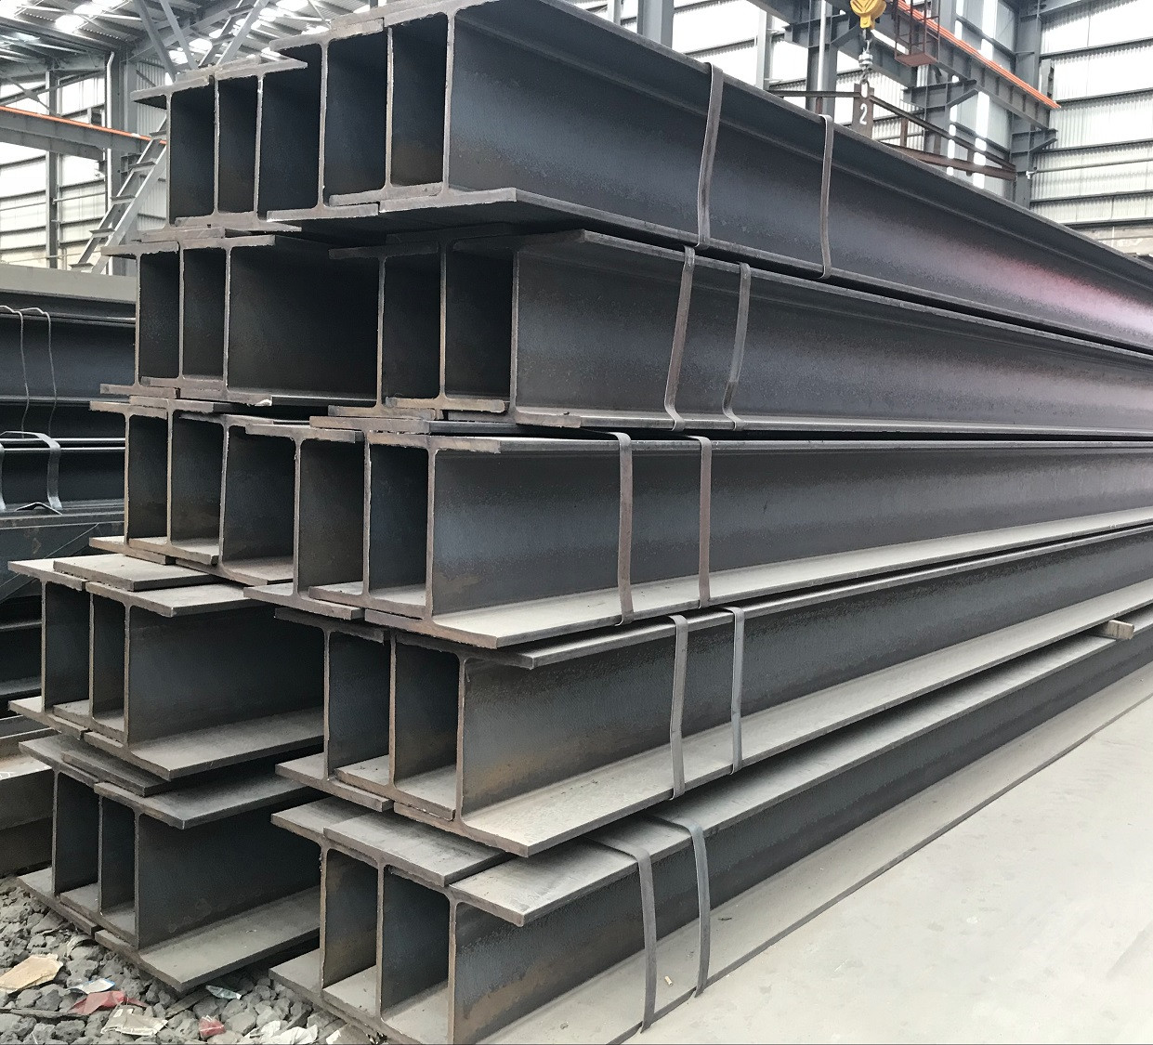
Steel H-Beams
Item Name | Structural Steel H Beam I Beam
MOQ | 1 Ton
Steel Grade | Q235B, Q355B, SS400B, A-36, AS300B, S355J0, S450J0-T, S275JR
Web Thickness | 5#-150# mm
Web Width | 100-1000 mm
Flange Thickness | 100-1000 mm
Flange Width | 100-1000 mm
Shape | H-Shape, L-Shape

Slide 36
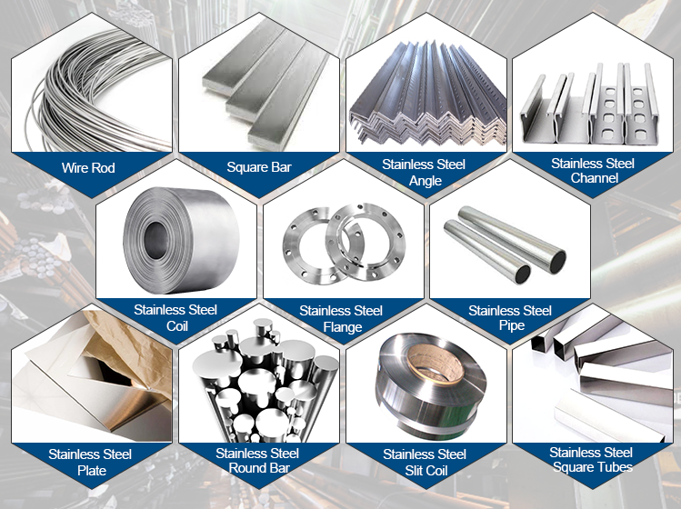
Related Products
在此添加标题

Slide 37
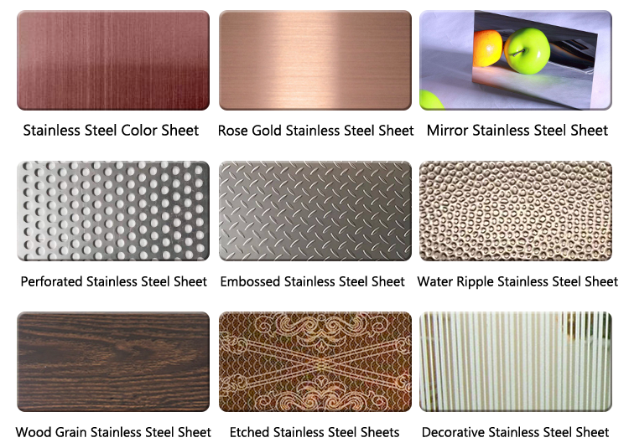
Surface Finish

Slide 38
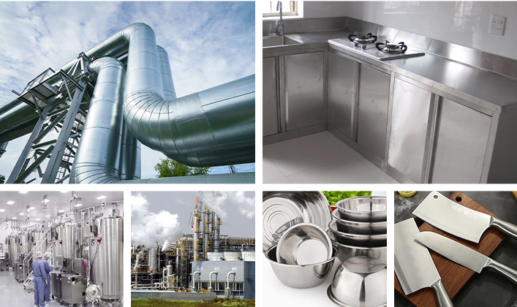
Application

Slide 39
Steel Grade & Size

Slide 40
Grade | Type | Thickness (mm) | Surface
Austenitic | 304/304H | 0.25-150 | 2B. BA. NO.4. 8K. SB. HL.NO.1
 | 304L | 0.3-150 | 2B. BA. NO.4. 8K. SB. HL.NO.1
 | 321 | 0.4-80 | 2B. BA. NO.4. 8K. SB. HL.NO.1
 | 316/316L/317L/316Ti | 0.3-80 | 2B. BA. NO.4. 8K. SB. HL.NO.1
 | 304J1 | 0.4-3.0 | 2B. BA. NO.4. 8K. SB. HL
Ferrite | 430 | 0.4-3.0 | 2B. BA. NO.4. 8K. SB. HL
Ultra Pure Ferrite | 443 | 0.4-2.0 | 2B
 | 436L/439/444/441 | 0.5-3.0
 | 409L | 0.4-2.5 | 2B. 2D
Duplex Steel | 2101 | 1.5-50 | 1D. NO.1. 2B. 2E
 | 2304 | 3.0-30 | 1D. NO.1. 2B. 2E
 | 2205 | 0.8-60 | 1D. NO.1. 2B. 2E
 | 2507 | 1.0-40 | 1D. NO.1. 2B. 2E

Slide 41
Grade | Type | Thickness (mm) | Surface
Heat-resistant Steel | 309S/310S | 0.5-40 | NO.1. 1D. 2B
Super Austenitic Steel | 904L | 0.6-50 | 1D. NO.1. 2B. 2E. NO.4
 | 254MO/S31254 | 0.5-30 | NO.1. 2B. 2E. BA. NO.4
 | N08926/N08367 | 0.5-30 | NO.1. 2B. 2D. NO.4
Nickel Base Alloy | 800/800H | 0.8-50 | NO.1. 2B. 2D
 | 825 | 0.8-40 | NO.1. 2B. 2D
 | 600 | 1.5-50 | 1D. NO.1. 2B. 2D
 | 625 | 0.8-20 | NO.1. 2B. 2D
 | 400 | 1.0-20 | NO.1. NO.4. 2D
 | C276 | 0.5-50 | NO.1. 2B. 2D
 | 201 | 0.5-20 | NO.1. 2B. 2D
Titanium | TA1/GR1 | 0.5-50
 | TA2/GR2 | 0.5-50

Slide 42
Thank you!

